Slide 1

William Stallings, Computer Organization and Architecture, 9th Edition
Chapter 14
Processor Structure and Function
Notes:
Lecture slides prepared for “Computer Organization and Architecture”, 9/e, by William Stallings, Chapter 14 “Processor Structure and Function”.
Adapted by Thân Văn Sử
This chapter discusses aspects of the processor not yet covered in Part Three and sets the stage for the discussion of RISC and superscalar architecture in Chapters 15 and 16.
We begin with a summary of processor organization. Registers, which form the internal memory of the processor, are then analyzed. We are then in a position to return to the discussion (begun in Section 3.2) of the instruction cycle. A description of the instruction cycle and a common technique known as instruction pipelining complete our description. The chapter concludes with an examination of some aspects of the x86 and ARM organizations.

Slide 2

Objectives
After studying this chapter, you should be able to:
Distinguish between user-visible and control/status registers, and discuss the purposes of registers in each category.
Summarize the instruction cycle.
Discuss the principle behind instruction pipelining and how it works in practice.
Compare and contrast the various forms of pipeline hazards (rủi ro).
Notes:
22

Slide 3
Contents
14.1 Processor Organization
14.2 Register Organization
14.3 Instruction Cycle
14.4 Instruction Pipelining
Notes:
22

Slide 4
14.1- Processor Organization
Processor Requirements:
Fetch instruction (from memory (register, cache, main memory))
Interpret instruction (what action is required)
Fetch data (data from memory or an I/O module)
Process data (performing some operations on data)
Write data (writing result to memory or an I/O module)
🡺 In order to do these things the processor needs to store some data temporarily and therefore needs a small internal memory
Notes:
22
To understand the organization of the processor, let us consider the requirements placed on the processor, the things that it must do:
Fetch instruction: The processor reads an instruction from memory (register, cache, main memory).
Interpret instruction: The instruction is decoded to determine what action is required.
Fetch data: The execution of an instruction may require reading data from memory or an I/O module.
Process data: The execution of an instruction may require performing some arithmetic or logical operation on data.
Write data: The results of an execution may require writing data to memory or an I/O module.
To do these things, it should be clear that the processor needs to store some data temporarily. It must remember the location of the last instruction so that it can know where to get the next instruction. It needs to store instructions and data temporarily while an instruction is being executed. In other words, the processor needs a small internal memory.

Slide 5
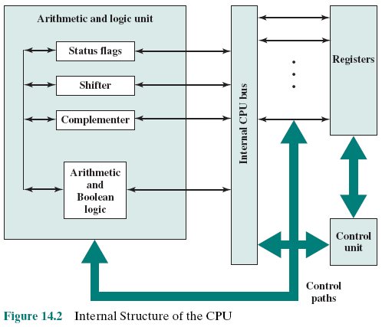
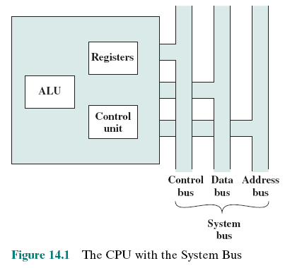
CPU With the System Bus and CPU Internal Structure
Notes:
Complementer: (unit for reserving bits – used in 2-complement operation, bộ bù- đảo bit – được dùng trong phép toán bù 2)
Figure 14.1 is a simplified view of a processor, indicating its connection to the rest of the system via the system bus. A similar interface would be needed for any of the interconnection structures described in Chapter 3. The reader will recall that the major components of the processor are an arithmetic and logic unit (ALU) and a control unit (CU). The ALU does the actual computation or processing of data. The control unit controls the movement of data and instructions into and out of the processor and controls the operation of the ALU. In addition, the figure shows a minimal internal memory, consisting of a set of storage locations, called registers. \
Figure 14.2 is a slightly more detailed view of the processor. The data transfer and logic control paths are indicated, including an element labeled internal
processor bus. This element is needed to transfer data between the various registers and the ALU because the ALU in fact operates only on data in the internal processor memory. The figure also shows typical basic elements of the ALU. Note the similarity between the internal structure of the computer as a whole and the internal structure of the processor. In both cases, there is a small collection of major elements (computer: processor, I/O, memory; processor: control unit, ALU, registers) connected by data paths.

Slide 6
14.2- Register Organization
Within the processor there is a set of registers that function as a level of memory above main memory and cache in the hierarchy
The registers in the processor perform two roles:
User-Visible Registers
Control and Status Registers
Enable the machine or assembly language programmer to minimize main memory references by optimizing use of registers
Used by the control unit to control the operation of the processor and by privileged operating system programs to control the execution of programs
Notes:
23
As we discussed in Chapter 4, a computer system employs a memory hierarchy. At higher levels of the hierarchy, memory is faster, smaller, and more expensive (per bit). Within the processor, there is a set of registers that function as a level of memory above main memory and cache in the hierarchy. The registers in the processor perform two roles:
User-visible registers: Enable the machine- or assembly language programmer to minimize main memory references by optimizing use of registers.
Control and status registers: Used by the control unit to control the operation of the processor and by privileged, operating system programs to control the execution of programs.
There is not a clean separation of registers into these two categories. For example, on some machines the program counter is user visible (e.g., x86), but on many it is not. For purposes of the following discussion, however, we will use these categories.

Slide 7
User-Visible Registers
Categories:
Referenced by means of the machine language that the processor executes
General purpose
Can be assigned to a variety of functions by the programmer
Data
May be used only to hold data and cannot be employed in the calculation of an operand address
Address
May be somewhat general purpose or may be devoted to a particular addressing mode
Examples: segment pointers, index registers, stack pointer
Condition codes
Also referred to as flags
Bits set by the processor hardware as the result of operations
Notes:
24
A user-visible register is one that may be referenced by means of the machine language that the processor executes. We can characterize these in the following categories:
General purpose
Data
Address
Condition codes
General-purpose registers can be assigned to a variety of functions by the programmer. Sometimes their use within the instruction set is orthogonal to the operation. That is, any general-purpose register can contain the operand for any opcode. This provides true general-purpose register use. Often, however, there are restrictions. For example, there may be dedicated registers for floating-point and stack operations.
In some cases, general-purpose registers can be used for addressing functions (e.g., register indirect, displacement). In other cases, there is a partial or clean separation between data registers and address registers. Data registers may be used only to hold data and cannot be employed in the calculation of an operand address.
Address registers may themselves be somewhat general purpose, or they may be
devoted to a particular addressing mode. Examples include the following:
Segment pointers: In a machine with segmented addressing (see Section 8.3), a segment register holds the address of the base of the segment. There may be multiple registers: for example, one for the operating system and one for the current process.
Index registers: These are used for indexed addressing and may be autoindexed.
Stack pointer: If there is user-visible stack addressing, then typically there is a dedicated register that points to the top of the stack. This allows implicit ad- dressing; that is, push, pop, and other stack instructions need not contain an explicit stack operand.
There are several design issues to be addressed here. An important issue is whether to use completely general-purpose registers or to specialize their use. We have already touched on this issue in the preceding chapter because it affects instruction set design. With the use of specialized registers, it can generally be implicit in the opcode which type of register a certain operand specifier refers to. The operand specifier must only identify one of a set of specialized registers rather than one out of all the registers, thus saving bits. On the other hand, this specialization limits the programmer’s flexibility.
Another design issue is the number of registers, either general purpose or data plus address, to be provided. Again, this affects instruction set design because more registers require more operand specifier bits. As we previously discussed, somewhere between 8 and 32 registers appears optimum [LUND77]. Fewer registers result in more memory references; more registers do not noticeably reduce memory references (e.g., see [WILL90]). However, a new approach, which finds advantage in the use of hundreds of registers, is exhibited in some RISC systems and is discussed in Chapter 15.
Finally, there is the issue of register length. Registers that must hold addresses obviously must be at least long enough to hold the largest address. Data registers should be able to hold values of most data types. Some machines allow two contiguous registers to be used as one for holding double-length values.
A final category of registers, which is at least partially visible to the user, holds condition codes (also referred to as flags). Condition codes are bits set by the processor hardware as the result of operations. For example, an arithmetic operation may produce a positive, negative, zero, or overflow result. In addition to the result itself being stored in a register or memory, a condition code is also set. The code may subsequently be tested as part of a conditional branch operation.
Condition code bits are collected into one or more registers. Usually, they form part of a control register. Generally, machine instructions allow these bits to be read by implicit reference, but the programmer cannot alter them.

Slide 8
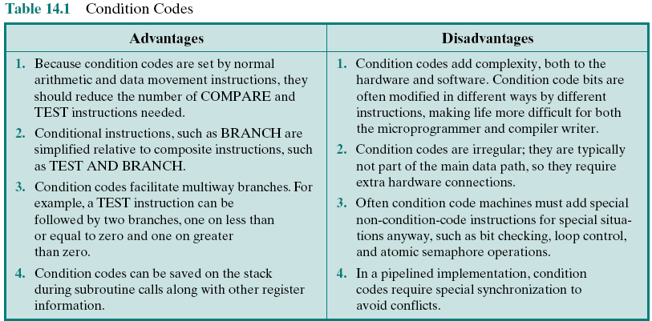
Table 14.1: Condition Codes
Notes:
27
Many processors, including those based on the IA-64 architecture and the MIPS processors, do not use condition codes at all. Rather, conditional branch instructions specify a comparison to be made and act on the result of the comparison, without storing a condition code. Table 14.1, based on [DERO87], lists key advantages and disadvantages of condition codes.
In some machines, a subroutine call will result in the automatic saving of all user-visible registers, to be restored on return. The processor performs the saving and restoring as part of the execution of call and return instructions. This allows each subroutine to use the user-visible registers independently. On other machines, it is the responsibility of the programmer to save the contents of the relevant user- visible registers prior to a subroutine call, by including instructions for this purpose in the program.

Slide 9
Control and Status Registers
Four registers are essential to instruction execution:
Program counter (PC)
Contains the address of an instruction to be fetched
Instruction register (IR)
Contains the instruction most recently fetched
Memory address register (MAR)
Contains the address of a location in memory
Memory buffer register (MBR)
Contains a word of data to be written to memory or the word most recently read
Notes:
30
There are a variety of processor registers that are employed to control the operation of the processor. Most of these, on most machines, are not visible to the user. Some of them may be visible to machine instructions executed in a control or operating system mode.
Of course, different machines will have different register organizations and use different terminology. We list here a reasonably complete list of register types, with a brief description.
Four registers are essential to instruction execution:
Program counter (PC): Contains the address of an instruction to be fetched.
Instruction register (IR): Contains the instruction most recently fetched.
Memory address register (MAR): Contains the address of a location in memory.
Memory buffer register (MBR): Contains a word of data to be written to memory or the word most recently read.
Not all processors have internal registers designated as MAR and MBR, but some equivalent buffering mechanism is needed whereby the bits to be transferred to the system bus are staged and the bits to be read from the data bus are temporarily stored.
Typically, the processor updates the PC after each instruction fetch so that the PC always points to the next instruction to be executed. A branch or skip instruction will also modify the contents of the PC. The fetched instruction is loaded into an IR, where the opcode and operand specifiers are analyzed. Data are exchanged with memory using the MAR and MBR. In a bus- organized system, the MAR connects directly to the address bus, and the MBR connects directly to the data bus. User-visible registers, in turn, exchange data with the MBR.
The four registers just mentioned are used for the movement of data between the processor and memory. Within the processor, data must be presented to the ALU for processing. The ALU may have direct access to the MBR and user-visible registers. Alternatively, there may be additional buffering registers at the boundary to the ALU; these registers serve as input and output registers for the ALU and exchange data with the MBR and user-visible registers.

Slide 10
Program Status Word (PSW)
Register or set of registers that contain status information
Status information are used to give a decision for branching
Common fields or flags include:
Sign
Zero
Carry
Equal
Overflow
Interrupt Enable/Disable
Supervisor
Notes:
31
Many processor designs include a register or set of registers, often known as the program status word (PSW), that contain status information. The PSW typically contains condition codes plus other status information. Common fields or flags include the following:
Sign: Contains the sign bit of the result of the last arithmetic operation.
Zero: Set when the result is 0.
Carry: Set if an operation resulted in a carry (addition) into or borrow (sub- traction) out of a high-order bit. Used for multiword arithmetic operations.
Equal: Set if a logical compare result is equality.
Overflow: Used to indicate arithmetic overflow.
Interrupt Enable/Disable: Used to enable or disable interrupts.
Supervisor: Indicates whether the processor is executing in supervisor or user mode. Certain privileged instructions can be executed only in supervisor mode, and certain areas of memory can be accessed only in supervisor mode.

Slide 11
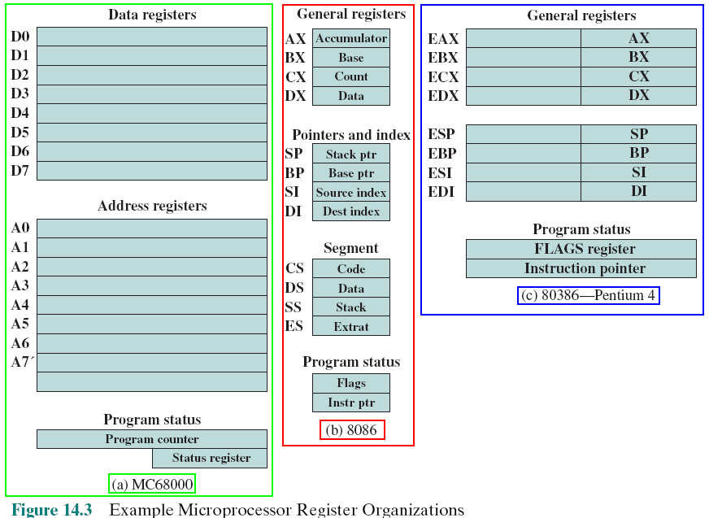
Example
Microprocessor
Register Organizations
Notes:
It is instructive to examine and compare the register organization of comparable systems. In this section, we look at two 16-bit microprocessors that were designed at about the same time: the Motorola MC68000 [STRI79] and the Intel 8086 [MORS78]. Figures 14.3a and b depict the register organization of each; purely internal registers, such as a memory address register, are not shown.
The MC68000 partitions its 32-bit registers into eight data registers and nine address registers. The eight data registers are used primarily for data manipulation and are also used in addressing as index registers. The width of the registers allows 8-, 16-, and 32-bit data operations, determined by opcode. The address registers contain 32-bit (no segmentation) addresses; two of these registers are also used as stack pointers, one for users and one for the operating system, depending on the current execution mode. Both registers are numbered 7, because only one can be used at a time. The MC68000 also includes a 32-bit program counter and a 16-bit status register.
The Intel 8086 takes a different approach to register organization. Every register is special purpose, although some registers are also usable as general purpose. The 8086 contains four 16-bit data registers that are addressable on a byte or 16-bit basis, and four 16-bit pointer and index registers. The data registers can be used as general purpose in some instructions. In others, the registers are used implicitly. For example, a multiply instruction always uses the accumulator. The four pointer registers are also used implicitly in a number of operations; each contains a segment offset. There are also four 16-bit segment registers. Three of the four segment registers are used in a dedicated, implicit fashion, to point to the segment of the current instruction (useful for branch instructions), a segment containing data, and a segment containing a stack, respectively. These dedicated and implicit uses provide for compact encoding at the cost of reduced flexibility. The 8086 also includes an instruction pointer and a set of 1-bit status and control flags.
The point of this comparison should be clear. There is no universally accepted philosophy concerning the best way to organize processor registers [TOON81]. As with overall instruction set design and so many other processor design issues, it is still a matter of judgment and taste.
A second instructive point concerning register organization design is illustrated in Figure 14.3c. This figure shows the user-visible register organization for the Intel 80386 [ELAY85], which is a 32-bit microprocessor designed as an extension of the 8086.1 The 80386 uses 32-bit registers. However, to provide upward compatibility for programs written on the earlier machine, the 80386 retains the original register organization embedded in the new organization. Given this design constraint, the architects of the 32-bit processors had limited flexibility in designing the register organization.

Slide 12
14.3-Instruction Cycle
Includes the following stages:
Fetch
Execute
Interrupt
Read the next instruction from memory into the processor
Interpret the opcode and perform the indicated operation
If interrupts are enabled and an interrupt has occurred, save the current process state and service the interrupt
Notes:
35
In Section 3.2, we described the processor’s instruction cycle (Figure 3.9). To recall, an instruction cycle includes the following stages:
Fetch: Read the next instruction from memory into the processor.
Execute: Interpret the opcode and perform the indicated operation.
Interrupt: If interrupts are enabled and an interrupt has occurred, save the current process state and service the interrupt.
We are now in a position to elaborate somewhat on the instruction cycle. First, we must introduce one additional stage, known as the indirect cycle.

Slide 13
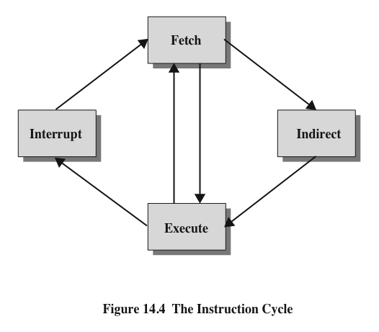
Instruction Cycle
Loop due to
additional memory accesses
Notes:
We have seen, in Chapter 13, that the execution of an instruction may involve one or more operands in memory, each of which requires a memory access. Further, if indirect addressing is used, then additional memory accesses are required.
We can think of the fetching of indirect addresses as one more instruction stages. The result is shown in Figure 14.4. The main line of activity consists of alternating instruction fetch and instruction execution activities. After an instruction is fetched, it is examined to determine if any indirect addressing is involved. If so, the required operands are fetched using indirect addressing. Following execution, an interrupt may be processed before the next instruction fetch.

Slide 14
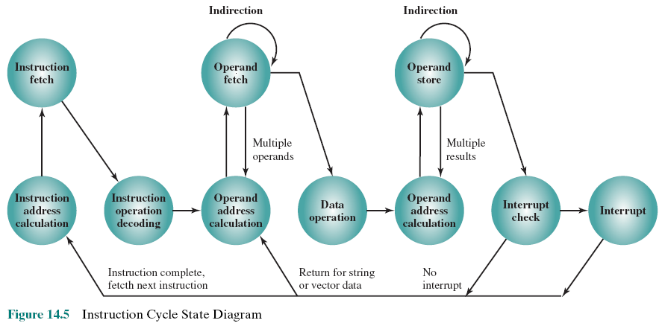
Instruction Cycle State Diagram
Fetch cycle
Indirect cycle
Interrupt cycle
Notes:
Another way to view this process is shown in Figure 14.5, which is a revised version of Figure 3.12. This illustrates more correctly the nature of the instruction cycle. Once an instruction is fetched, its operand specifiers must be identified. Each input operand in memory is then fetched, and this process may require indirect addressing. Register-based operands need not be fetched. Once the opcode is executed, a similar process may be needed to store the result in main memory.

Slide 15
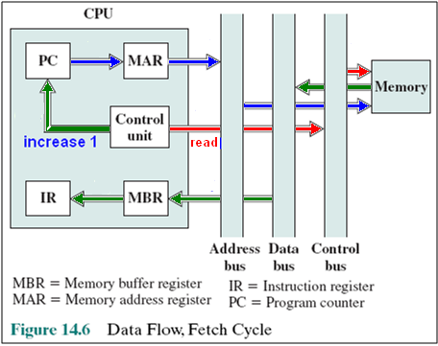
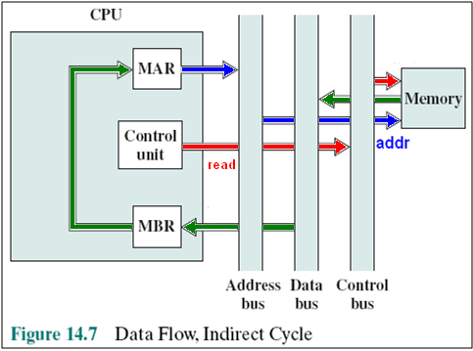
Data Flow, Fetch Cycle
Fetch cycle for the next instruction
(Instruction index is in PC)
MAR: Memory Address Register
MBR: Memory buffer Register
The CU examines the contents of the IR to determine if it contains an operand specified by indirect addressing🡪 Use indirect cycle(data address is in MBR)
Notes:
The exact sequence of events during an instruction cycle depends on the design of the processor. We can, however, indicate in general terms what must happen. Let us assume that a processor that employs a memory address register (MAR), a memory buffer register (MBR), a program counter (PC), and an instruction register (IR).
During the fetch cycle, an instruction is read from memory. Figure 14.6 shows the flow of data during this cycle. The PC contains the address of the next instruction to be fetched. This address is moved to the MAR and placed on the address bus. The control unit requests a memory read, and the result is placed on the data bus and copied into the MBR and then moved to the IR. Meanwhile, the PC is incremented by 1, preparatory for the next fetch.
Once the fetch cycle is over, the control unit examines the contents of the IR to determine if it contains an operand specifier using indirect addressing. If so, an indirect cycle is performed. As shown in Figure 14.7, this is a simple cycle. The right- most N bits of the MBR, which contain the address reference, are transferred to the MAR. Then the control unit requests a memory read, to get the desired address of the operand into the MBR.
The fetch and indirect cycles are simple and predictable. The execute cycle takes many forms; the form depends on which of the various machine instructions is in the IR. This cycle may involve transferring data among registers, read or write from memory or I/O, and/or the invocation of the ALU.

Slide 16
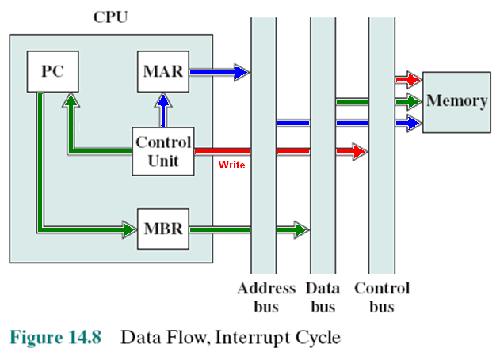
Data Flow, Interrupt Cycle
Store PC (return point after executing interrupt routine)
Store current state (values in registers before running interrupt routine)
Fetch cycle is used to load interrupt routine
Notes:
Like the fetch and indirect cycles, the interrupt cycle is simple and predictable (Figure 14.8). The current contents of the PC must be saved so that the processor can resume normal activity after the interrupt. Thus, the contents of the PC are transferred to the MBR to be written into memory. The special memory location reserved for this purpose is loaded into the MAR from the control unit. It might, for example, be a stack pointer. The PC is loaded with the address of the interrupt routine. As a result, the next instruction cycle will begin by fetching the appropriate instruction.

Slide 17
14.4- Instruction Pipelining Pipelining Strategy
A way to improve performance is performing jobs in parallel manner
Similar to the use of an assembly line in a manufacturing plant
To apply this concept to instruction execution we must recognize that an instruction has a number of stages
New inputs are accepted at one end before previously accepted inputs appear as outputs at the other end
An assembly line (dây chuyền lắp ráp) in which some operations are performed
concurrently
Notes:
38
Instruction pipelining is similar to the use of an assembly line in a manufacturing plant. An assembly line takes advantage of the fact that a product goes through various stages of production. By laying the production process out in an assembly line, products at various stages can be worked on simultaneously. This process is also referred to as pipelining, because, as in a pipeline, new inputs are accepted at one end before previously accepted inputs appear as outputs at the other end.
To apply this concept to instruction execution, we must recognize that, in fact, an instruction has a number of stages. Figures 14.5, for example, breaks the instruction cycle up into 10 tasks, which occur in sequence. Clearly, there should be some opportunity for pipelining.

Slide 18
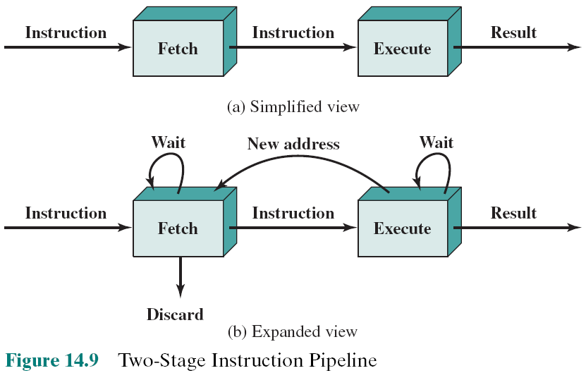
Two-Stage Instruction Pipeline
Notes:
As a simple approach, consider subdividing instruction processing into two stages: fetch instruction and execute instruction. There are times during the execution of an instruction when main memory is not being accessed. This time could be used to fetch the next instruction in parallel with the execution of the current one. Figure 14.9a depicts this approach. The pipeline has two independent stages. The first stage fetches an instruction and buffers it. When the second stage is free, the first stage passes it the buffered instruction. While the second stage is executing the instruction, the first stage takes advantage of any unused memory cycles to fetch and buffer the next instruction. This is called instruction prefetch or fetch overlap. Note that this approach, which involves instruction buffering, requires more registers. In general, pipelining requires registers to store data between stages.
It should be clear that this process will speed up instruction execution. If the fetch and execute stages were of equal duration, the instruction cycle time would be halved. However, if we look more closely at this pipeline (Figure 14.9b), we will see that this doubling of execution rate is unlikely for two reasons:
The execution time will generally be longer than the fetch time. Execution will involve reading and storing operands and the performance of some operation. Thus, the fetch stage may have to wait for some time before it can empty its buffer.
A conditional branch instruction makes the address of the next instruction to be fetched unknown. Thus, the fetch stage must wait until it receives the next instruction address from the execute stage. The execute stage may then have to wait while the next instruction is fetched.
Guessing can reduce the time loss from the second reason. A simple rule is the following: When a conditional branch instruction is passed on from the fetch to the execute stage, the fetch stage fetches the next instruction in memory after the branch instruction. Then, if the branch is not taken, no time is lost. If the branch is taken, the fetched instruction must be discarded and a new instruction fetched.

Slide 19
Additional Stages
Fetch instruction (FI)
Read the next expected instruction into a buffer
Decode instruction (DI)
Determine the opcode and the operand specifiers
Calculate operands (CO)
Calculate the effective address of each source operand
This may involve displacement, register indirect, indirect, or other forms of address calculation
Fetch operands (FO)
Fetch each operand from memory
Operands in registers need not be fetched
Execute instruction (EI)
Perform the indicated operation and store the result, if any, in the specified destination operand location
Write operand (WO)
Store the result in memory
Notes:
While these factors reduce the potential effectiveness of the two-stage pipe- line, some speedup occurs. To gain further speedup, the pipeline must have more stages. Let us consider the following decomposition of the instruction processing.
Fetch instruction (FI): Read the next expected instruction into a buffer.
Decode instruction (DI): Determine the opcode and the operand specifiers.
Calculate operands (CO): Calculate the effective address of each source operand. This may involve displacement, register indirect, indirect, or other forms of address calculation.
Fetch operands (FO): Fetch each operand from memory. Operands in registers need not be fetched.
Execute instruction (EI): Perform the indicated operation and store the result, if any, in the specified destination operand location.
Write operand (WO): Store the result in memory.
With this decomposition, the various stages will be of more nearly equal duration.

Slide 20
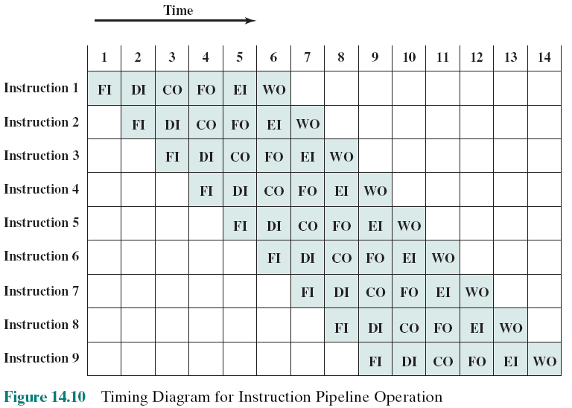
Timing Diagram for Instruction Pipeline Operation
I: Instruction
O: operand
F: Fetch
C: Calculate
E: Execute
W: Write
Notes:
39
For the sake of illustration, let us assume equal duration. Using this assumption, Figure 14.10 shows that a six-stage pipeline can reduce the execution time for 9 instructions from 54 time units to 14 time units.
Several comments are in order: The diagram assumes that each instruction goes through all six stages of the pipeline. This will not always be the case. For example, a load instruction does not need the WO stage. However, to simplify the pipeline hardware, the timing is set up assuming that each instruction requires all six stages. Also, the diagram assumes that all of the stages can be performed in parallel. In particular, it is assumed that there are no memory conflicts. For example, the FI, FO, and WO stages involve a memory access. The diagram implies that all these accesses can occur simultaneously. Most memory systems will not permit that. However, the desired value may be in cache, or the FO or WO stage may be null. Thus, much of the time, memory conflicts will not slow down the pipeline.

Slide 21
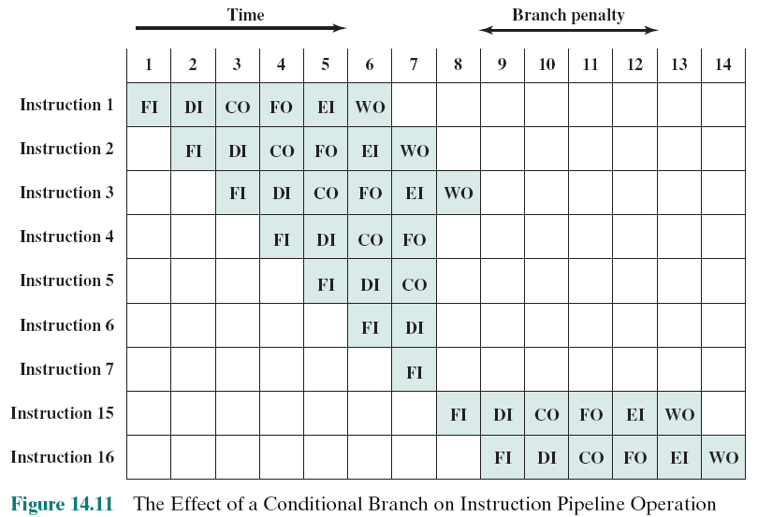
The Effect of a Conditional Branch on Instruction Pipeline Operation
At the time 7, the instruction 3 executes and the instruction 15 is loaded.
These jobs are wasted
Suppose that the instruction 3 is a branch to the instruction 15
Notes:
40
Several other factors serve to limit the performance enhancement. If the six stages are not of equal duration, there will be some waiting involved at various pipe- line stages, as discussed before for the two-stage pipeline. Another difficulty is the conditional branch instruction, which can invalidate several instruction fetches. A similar unpredictable event is an interrupt. Figure 14.11 illustrates the effects of the conditional branch, using the same program as Figure 14.10. Assume that instruction 3 is a conditional branch to instruction 15. Until the instruction is executed, there is no way of knowing which instruction will come next. The pipeline, in this example, simply loads the next instruction in sequence (instruction 4) and proceeds. In Figure 14.10, the branch is not taken, and we get the full performance benefit of the enhancement. In Figure 14.11, the branch is taken. This is not determined until the end of time unit 7. At this point, the pipeline must be cleared of instructions that are not useful. During time unit 8, instruction 15 enters the pipeline. No instructions complete during time units 9 through 12; this is the performance penalty incurred because we could not anticipate the branch.

Slide 22
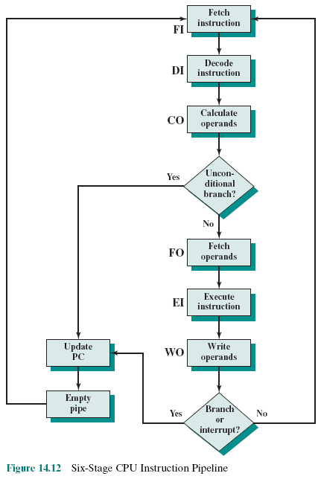
Six Stage Instruction Pipeline
Figure 14.12 indicates the logic needed for pipelining to account for branches and interrupts
Notes:
Figure 14.12 indicates the logic needed for pipelining to account for branches and interrupts.
Other problems arise that did not appear in our simple two-stage organization. The CO stage may depend on the contents of a register that could be altered by a previous instruction that is still in the pipeline. Other such register and memory conflicts could occur. The system must contain logic to account for this type of conflict.

Slide 23
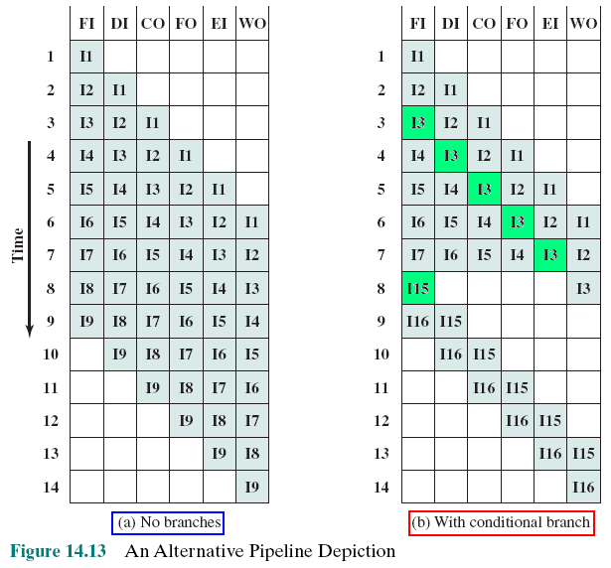
Alternative Pipeline Depiction
I3 is a conditional branch to I15
Notes:
To clarify pipeline operation, it might be useful to look at an alternative depiction. Figures 14.10 and 14.11 show the progression of time horizontally across the figures, with each row showing the progress of an individual instruction. Figure 14.13 shows same sequence of events, with time progressing vertically down the figure, and each row showing the state of the pipeline at a given point in time. In Figure 14.13a (which corresponds to Figure 14.10), the pipeline is full at time 6, with 6 different instructions in various stages of execution, and remains full through time 9; we assume that instruction I9 is the last instruction to be executed. In Figure 14.13b, (which corresponds to Figure 14.11), the pipeline is full at times 6 and 7. At time 7, instruction 3 is in the execute stage and executes a branch to instruction 15. At this point, instructions I4 through I7 are flushed from the pipeline, so that at time 8, only two instructions are in the pipeline, I3 and I15.

Slide 24
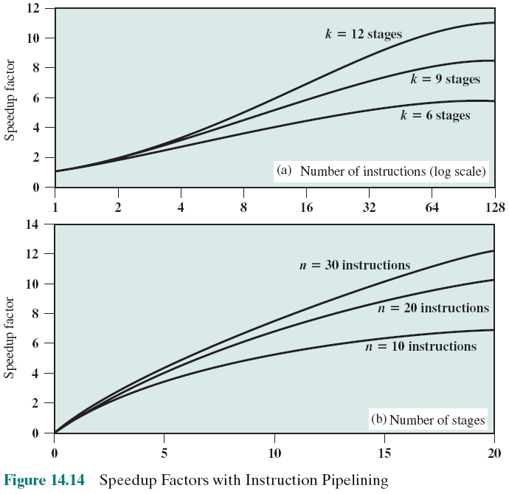
Speedup Factors with Instruction Pipelining
number of instructions that are executed without a branch
The larger the number of pipeline stages, the greater the potential for speedup 🡺 higher COST
Notes:
Figure 14.14a plots the speedup factor as a function of the number of instructions that are executed without a branch.
Figure 14.14b shows the speedup factor as a function of the number of stages in the instruction pipeline
Thus, the larger the number of pipeline stages, the greater the potential for speedup. However, as a practical matter, the potential gains of additional pipe- line stages are countered by increases in cost, delays between stages, and the fact that branches will be encountered requiring the flushing of the pipeline.

Slide 25

Pipeline Hazards (rủi ro)
Occur when the pipeline, or some portion of the pipeline, must stall (trì hoãn) because conditions do not permit continued execution
Also referred to as a pipeline bubble
There are three types of hazards:
Resource
Data
Control
Notes:
In the previous subsection, we mentioned some of the situations that can result in less than optimal pipeline performance. In this subsection, we examine this issue in a more systematic way. Chapter 16 revisits this issue, in more detail, after we have introduced the complexities found in superscalar pipeline organizations.
A pipeline hazard occurs when the pipeline, or some portion of the pipeline, must stall because conditions do not permit continued execution. Such a pipe- line stall is also referred to as a pipeline bubble. There are three types of hazards: resource, data, and control.

Slide 26
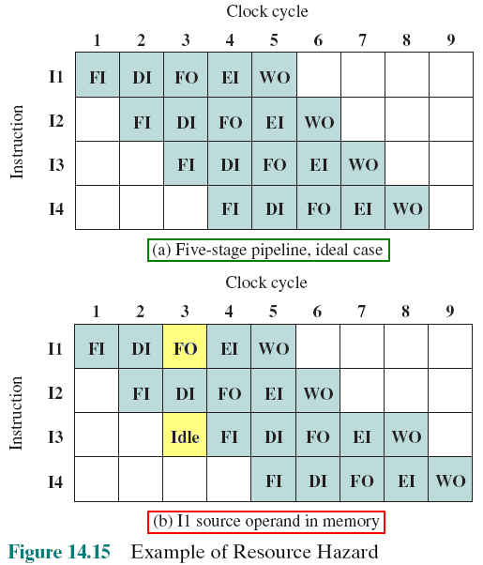
Resource Hazards
A resource hazard occurs when two or more instructions that are already in the pipeline need the same resource
The result is that the instructions must be executed in serial rather than parallel for a portion of the pipeline
A resource hazard is sometimes referred to as a structural hazard
FO is accessing memory. So, this step is idle
Notes:
A resource hazard occurs when two (or more) instructions that are already in the pipeline need the same resource. The result is that the instructions must be executed in serial rather than parallel for a portion of the pipeline. A resource hazard is sometime referred to as a structural hazard.
Let us consider a simple example of a resource hazard. Assume a simplified five-stage pipeline, in which each stage takes one clock cycle. Figure 14.15a shows the ideal case, in which a new instruction enters the pipeline each clock cycle. Now assume that main memory has a single port and that all instruction fetches and data reads and writes must be performed one at a time. Further, ignore the cache. In this case, an operand read to or write from memory cannot be performed in parallel with an instruction fetch. This is illustrated in Figure 14.15b, which assumes that the source operand for instruction I1 is in memory, rather than a register. Therefore, the fetch instruction stage of the pipeline must idle for one cycle before beginning the instruction fetch for instruction I3. The figure assumes that all other operands are in registers.
Another example of a resource conflict is a situation in which multiple instructions are ready to enter the execute instruction phase and there is a single ALU. One solutions to such resource hazards is to increase available resources, such as having multiple ports into main memory and multiple ALU units.

Slide 27
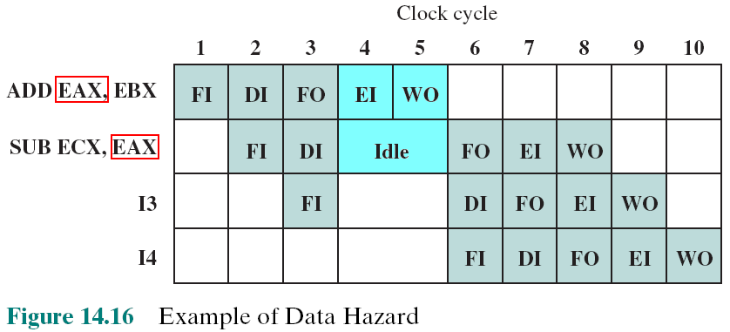
Data Hazards
A data hazard occurs when there is a conflict in the access of an operand location
RAW
Instruction is executing and the register EAX is writing to. So, it can not be read.
Hazard
X86
instruction
Notes:
A data hazard occurs when there is a conflict in the access of an operand location. In general terms, we can state the hazard in this form: Two instructions in a program are to be executed in sequence and both access a particular memory or register operand. If the two instructions are executed in strict sequence, no problem occurs. However, if the instructions are executed in a pipeline, then it is possible for the operand value to be updated in such a way as to produce a different result than would occur with strict sequential execution. In other words, the program produces an incorrect result because of the use of pipelining.

Slide 28
Types of Data Hazard
Read after write (RAW), or true dependency
An instruction modifies a register or memory location
Succeeding instruction reads data in memory or register location
Hazard occurs if the read takes place before write operation is complete
Write after read (WAR), or antidependency
An instruction reads a register or memory location
Succeeding instruction writes to the location
Hazard occurs if the write operation completes before the read operation takes place
Write after write (WAW), or output dependency
Two instructions both write to the same location
Hazard occurs if the write operations take place in the reverse order of the intended sequence
Notes:
There are three types of data hazards;
• Read after write (RAW), or true dependency: An instruction modifies a register or memory location and a succeeding instruction reads the data in that memory or register location. A hazard occurs if the read takes place before the write operation is complete.
• Write after read (WAR), or antidependency: An instruction reads a register or memory location and a succeeding instruction writes to the location. A hazard occurs if the write operation completes before the read operation takes place.
• Write after write (WAW), or output dependency: Two instructions both write to the same location. A hazard occurs if the write operations take place in the reverse order of the intended sequence.
The example of Figure 14.16 is a RAW hazard. The other two hazards are best discussed in the context of superscalar organization, discussed in Chapter 16.

Slide 29
Control Hazard
Also known as a branch hazard
Occurs when the pipeline makes the wrong decision on a branch prediction
Brings instructions into the pipeline that must subsequently be discarded
Dealing with Branches:
Multiple streams
Prefetch branch target
Loop buffer
Branch prediction
Delayed branch
Notes:
A control hazard, also known as a branch hazard, occurs when the pipeline makes the wrong decision on a branch prediction and therefore brings instructions into the pipeline that must subsequently be discarded. We discuss approaches to dealing with control hazards next.
One of the major problems in designing an instruction pipeline is assuring a steady flow of instructions to the initial stages of the pipeline. The primary impediment, as we have seen, is the conditional branch instruction. Until the instruction is actually executed, it is impossible to determine whether the branch will be taken or not.
A variety of approaches have been taken for dealing with conditional branches:
Multiple streams
Prefetch branch target
Loop buffer
Branch prediction
Delayed branch

Slide 30
Multiple Streams
A simple pipeline suffers a penalty for a branch instruction because it must choose one of two instructions to fetch next and may make the wrong choice
A brute-force approach is to replicate the initial portions of the pipeline and allow the pipeline to fetch both instructions, making use of two streams
brute-force search or exhaustive search (vét cạn)
Drawbacks:
With multiple pipelines there are contention delays for access to the registers and to memory
Additional branch instructions may enter the pipeline before the original branch decision is resolved
Notes:
42
A simple pipeline suffers a penalty for a branch instruction because it must choose one of two instructions to fetch next and may make the wrong choice. A brute-force approach is to replicate the initial portions of the pipeline and allow the pipeline to fetch both instructions, making use of two streams. There are two problems with this approach:
With multiple pipelines there are contention delays for access to the registers and to memory.
Additional branch instructions may enter the pipeline (either stream) before the original branch decision is resolved. Each such instruction needs an additional stream.
Despite these drawbacks, this strategy can improve performance. Examples of machines with two or more pipeline streams are the IBM 370/168 and the IBM 3033.

Slide 31

Prefetch Branch Target
When a conditional branch is recognized, the target of the branch is prefetched, in addition to the instruction following the branch
Target is then saved until the branch instruction is executed
If the branch is taken, the target has already been prefetched
IBM 360/91 uses this approach
Notes:
43
When a conditional branch is recognized, the target of the branch is prefetched, in addition to the instruction following the branch. This target is then saved until the branch instruction is executed. If the branch is taken, the target has already been prefetched.
The IBM 360/91 uses this approach.

Slide 32
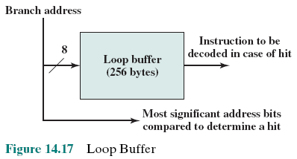
Loop Buffer
Small, very-high speed memory maintained by the instruction fetch stage of the pipeline and containing the n most recently fetched instructions, in sequence
Benefits:
Instructions fetched in sequence will be available without the usual memory access time
If a branch occurs to a target just a few locations ahead of the address of the branch instruction, the target will already be in the buffer
This strategy is particularly well suited to dealing with loops
Similar in principle to a cache dedicated to instructions. Differences:
The loop buffer only retains instructions in sequence
Is much smaller in size and hence lower in cost
Notes:
44
A loop buffer is a small, very-high-speed memory maintained by the instruction fetch stage of the pipeline and containing the n most recently fetched instructions, in sequence. If a branch is to be taken, the hardware first checks whether the branch target is within the buffer. If so, the next instruction is fetched from the buffer. The loop buffer has three benefits:
1. With the use of prefetching, the loop buffer will contain some instruction sequentially ahead of the current instruction fetch address. Thus, instructions fetched in sequence will be available without the usual memory access time.
2. If a branch occurs to a target just a few locations ahead of the address of the branch instruction, the target will already be in the buffer. This is useful for the rather common occurrence of IF–THEN and IF–THEN–ELSE sequences.
3. This strategy is particularly well suited to dealing with loops, or iterations; hence the name loop buffer. If the loop buffer is large enough to contain all the instructions in a loop, then those instructions need to be fetched from memory only once, for the first iteration. For subsequent iterations, all the needed instructions are already in the buffer.
The loop buffer is similar in principle to a cache dedicated to instructions. The differences are that the loop buffer only retains instructions in sequence and is much smaller in size and hence lower in cost.

Slide 33
Branch Prediction
Various techniques can be used to predict whether a branch will be taken:
Predict never taken
Predict always taken
Predict by opcode
Taken/not taken switch
Branch history table
These approaches are static
They do not depend on the execution history up to the time of the conditional branch instruction
These approaches are dynamic
They depend on the execution history
How are predictions carried out?
Next slide
🡺 States of some last instructions (some bits) must be stores in cache
Notes:
45
Various techniques can be used to predict whether a branch will be taken. Among the more common are the following:
• • • • •
Predict never taken
Predict always taken
Predict by opcode
Taken/not taken switch
Branch history table
The first three approaches are static: they do not depend on the execution history up to the time of the conditional branch instruction. The latter two approaches are dynamic: They depend on the execution history.
The first two approaches are the simplest. These either always assume that the branch will not be taken and continue to fetch instructions in sequence, or they always assume that the branch will be taken and always fetch from the branch tar- get. The predict-never-taken approach is the most popular of all the branch prediction methods.
Studies analyzing program behavior have shown that conditional branches are taken more than 50% of the time [LILJ88], and so if the cost of prefetching from either path is the same, then always prefetching from the branch target address should give better performance than always prefetching from the sequential path. However, in a paged machine, prefetching the branch target is more likely to cause a page fault than prefetching the next instruction in sequence, and so this performance penalty should be taken into account. An avoidance mechanism may be employed to reduce this penalty.
The final static approach makes the decision based on the opcode of the branch instruction. The processor assumes that the branch will be taken for certain branch opcodes and not for others. [LILJ88] reports success rates of greater than 75% with this strategy.
Dynamic branch strategies attempt to improve the accuracy of prediction by recording the history of conditional branch instructions in a program. For example, one or more bits can be associated with each conditional branch instruction that reflect the recent history of the instruction. These bits are referred to as a taken/ not taken switch that directs the processor to make a particular decision the next time the instruction is encountered. Typically, these history bits are not associated with the instruction in main memory. Rather, they are kept in temporary high- speed storage. One possibility is to associate these bits with any conditional branch instruction that is in a cache. When the instruction is replaced in the cache, its history is lost. Another possibility is to maintain a small table for recently executed branch instructions with one or more history bits in each entry. The processor could access the table associatively, like a cache, or by using the low-order bits of the branch instruction’s address.

Slide 34
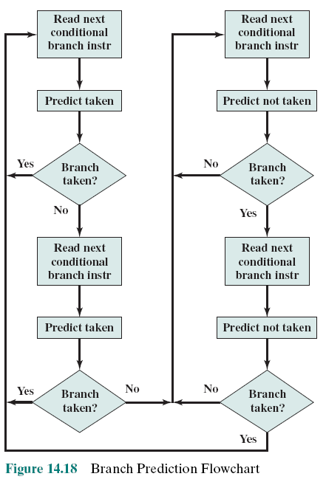
Branch Prediction Flow Chart
If only one bit is stored, a loop may cause 2 errors in prediction: once on entering and once on exiting.
If 2 bits are stored, a prediction algorithm is carried out using 2 branches (fig. 14.18)
Notes:
With a single bit, all that can be recorded is whether the last execution of this instruction resulted in a branch or not. A shortcoming of using a single bit appears in the case of a conditional branch instruction that is almost always taken, such as a loop instruction. With only one bit of history, an error in prediction will occur twice for each use of the loop: once on entering the loop, and once on exiting.
If two bits are used, they can be used to record the result of the last two instances of the execution of the associated instruction, or to record a state in some other fashion. Figure 14.18 shows a typical approach (see Problem 14.13 for other possibilities). Assume that the algorithm starts at the upper-left-hand corner of the flowchart. As long as each succeeding conditional branch instruction that is encountered is taken, the decision process predicts that the next branch will be taken. If a single prediction is wrong, the algorithm continues to predict that the next branch is taken. Only if two successive branches are not taken does the algorithm shift to the right-hand side of the flowchart. Subsequently, the algorithm will predict that branches are not taken until two branches in a row are taken. Thus, the algorithm requires two consecutive wrong predictions to change the prediction decision.

Slide 35
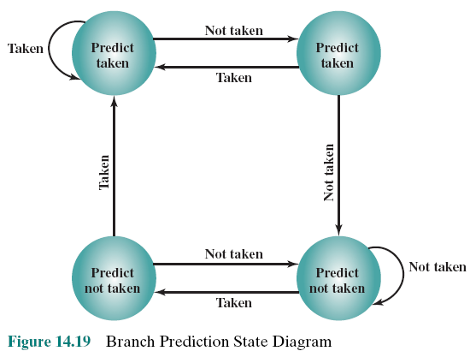
Branch Prediction State Diagram
The decision process can be represented more compactly by a finite-state machine
Finite-state machine is a way to express a processing mechanism in which each part of input will determine a step of the process.
Some bits are stored: 0: Not taken, 1: Taken. A history can be as 01110
Notes:
The decision process can be represented more compactly by a finite-state machine, shown in Figure 14.19. The finite-state machine representation is commonly used in the literature.
The use of history bits, as just described, has one drawback: If the decision is made to take the branch, the target instruction cannot be fetched until the tar- get address, which is an operand in the conditional branch instruction, is decoded. Greater efficiency could be achieved if the instruction fetch could be initiated as soon as the branch decision is made. For this purpose, more information must be saved, in what is known as a branch target buffer, or a branch history table.
The branch history table is a small cache memory associated with the instruction fetch stage of the pipeline. Each entry in the table consists of three elements: the address of a branch instruction, some number of history bits that record the state of use of that instruction, and information about the target instruction. In most proposals and implementations, this third field contains the address of the target instruction. Another possibility is for the third field to actually contain the target instruction. The trade-off is clear: Storing the target address yields a smaller table but a greater instruction fetch time compared with storing the target instruction [RECH98].

Slide 36
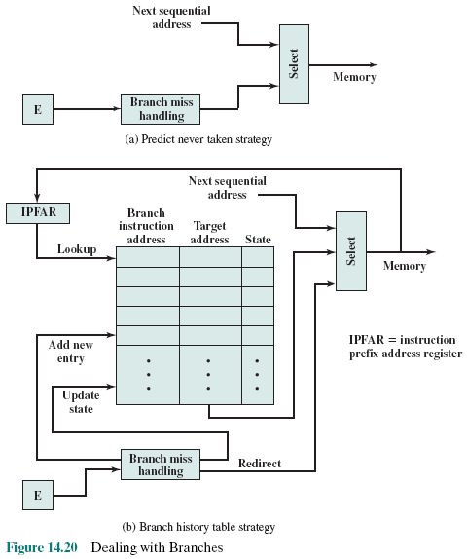
Dealing With Branches
Each prefetch triggers a lookup in the table.
No match: Fetch next sequential address.
Match: a prediction is made based on the state of the instruction: Either the next sequential address or the branch target address is fed to the select logic.
branch history table
Notes:
Figure 14.20 contrasts this scheme with a predict-never-taken strategy. With the former strategy, the instruction fetch stage always fetches the next sequential address. If a branch is taken, some logic in the processor detects this and instructs that the next instruction be fetched from the target address (in addition to flushing the pipeline). The branch history table is treated as a cache. Each prefetch triggers a lookup in the branch history table. If no match is found, the next sequential address is used for the fetch. If a match is found, a prediction is made based on the state of the instruction: Either the next sequential address or the branch target address is fed to the select logic.
When the branch instruction is executed, the execute stage signals the branch history table logic with the result. The state of the instruction is updated to reflect a correct or incorrect prediction. If the prediction is incorrect, the select logic is redirected to the correct address for the next fetch. When a conditional branch instruction is encountered that is not in the table, it is added to the table and one of the existing entries is discarded, using one of the cache replacement algorithms discussed in Chapter 4.
A refinement of the branch history approach is referred to as two-level or correlation-based branch history [YEH91]. This approach is based on the assumption that whereas in loop-closing branches, the past history of a particular branch instruction is a good predictor of future behavior, with more complex control-flow structures, the direction of a branch is frequently correlated with the direction of related branches. An example is an if-then-else or case structure. There are a number of strategies possible. Typically, recent global branch history (i.e., the history of the most recent branches not just of this branch instruction) is used in addition to the history of the current branch instruction. The general structure is defined as an (m, n) correlator, which uses the behavior of the last m branches to choose from 2^{m}n-bit branch predictors for the current branch instruction. In other words, an n-bit history is kept for a give branch for each possible combination of branches taken by the most recent m branches.

Slide 37
Delayed Branch
It is possible to improve pipeline performance by automatically rearranging instructions within a program, so that branch instructions occur later than actually desired. This intriguing approach is examined in Chapter 15.

Slide 38
Intel 80486 Pipelining
Fetch
Objective is to fill the prefetch buffers with new data as soon as the old data have been consumed by the instruction decoder
Operates independently of the other stages to keep the prefetch buffers full
Decode stage 1
All opcode and addressing-mode information is decoded in the D1 stage
3 bytes of instruction are passed to the D1 stage from the prefetch buffers
D1 decoder can then direct the D2 stage to capture the rest of the instruction
Decode stage 2
Expands each opcode into control signals for the ALU
Also controls the computation of the more complex addressing modes
Execute
Stage includes ALU operations, cache access, and register update
Write back
Updates registers and status flags modified during the preceding execute stage
Notes:
An instructive example of an instruction pipeline is that of the Intel 80486. The 80486 implements a five-stage pipeline:
Fetch: Instructions are fetched from the cache or from external memory and placed into one of the two 16-byte prefetch buffers. The objective of the fetch stage is to fill the prefetch buffers with new data as soon as the old data have been consumed by the instruction decoder. Because instructions are of variable length (from 1 to 11 bytes not counting prefixes), the status of the prefetcher relative to the other pipeline stages varies from instruction to instruction. On average, about five instructions are fetched with each 16-byte load [CRAW90]. The fetch stage operates independently of the other stages to keep the prefetch buffers full.
Decode stage 1: All opcode and addressing-mode information is decoded in the D1 stage. The required information, as well as instruction-length information, is included in at most the first 3 bytes of the instruction. Hence, 3 bytes are passed to the D1 stage from the prefetch buffers. The D1 decoder can then direct the D2 stage to capture the rest of the instruction (displacement and immediate data), which is not involved in the D1 decoding.
Decode stage 2: The D2 stage expands each opcode into control signals for the ALU. It also controls the computation of the more complex addressing modes.
Execute: This stage includes ALU operations, cache access, and register update.
Write back: This stage, if needed, updates registers and status flags modified during the preceding execute stage. If the current instruction updates memory, the computed value is sent to the cache and to the bus-interface write buffers at the same time.
With the use of two decode stages, the pipeline can sustain a throughput of close to one instruction per clock cycle. Complex instructions and conditional branches can slow down this rate.

Slide 39
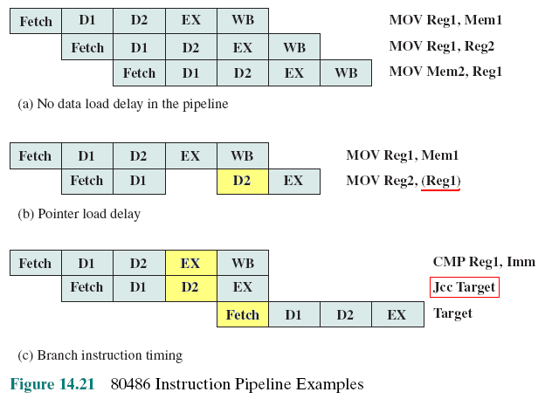
80486 Instruction Pipeline Examples
Notes:
Figure 14.21 shows examples of the operation of the pipeline. Figure 14.21a shows that there is no delay introduced into the pipeline when a memory access is required. However, as Figure 14.21b shows, there can be a delay for values used to compute memory addresses. That is, if a value is loaded from memory into a register and that register is then used as a base register in the next instruction, the processor will stall for one cycle. In this example, the processor accesses the cache in the EX stage of the first instruction and stores the value retrieved in the register during the WB stage. However, the next instruction needs this register in its D2 stage. When the D2 stage lines up with the WB stage of the previous instruction, bypass signal paths allow the D2 stage to have access to the same data being used by the WB stage for writing, saving one pipeline stage.
Figure 14.21c illustrates the timing of a branch instruction, assuming that the branch is taken. The compare instruction updates condition codes in the WB stage, and bypass paths make this available to the EX stage of the jump instruction at the same time. In parallel, the processor runs a speculative fetch cycle to the target of the jump during the EX stage of the jump instruction. If the processor determines a false branch condition, it discards this prefetch and continues execution with the next sequential instruction (already fetched and decoded).

Slide 40
Exercises
14.1 What general roles are performed by processor registers?
14.2 What categories of data are commonly supported by user-visible registers?
14.3 What is the function of condition codes?
14.4 What is a program status word?
14.5 Why is a two-stage instruction pipeline unlikely to cut the instruction cycle time in half, compared with the use of no pipeline?
14.6 List and briefly explain various ways in which an instruction pipeline can deal with conditional branch instructions.
14.7 How are history bits used for branch prediction?

Slide 41
Exercises
14.8 - what would be the value of the following flags: Carry, Zero, Overflow, Sign, Even Parity , Half-Carry ?
(a) If the last operation performed on a computer with an 8-bit word was an addition in which the two operands were 00000010 and 00000011.
(b) Repeat for the addition of -1 (twos complement) and +1.
(c) A - B, where A contains 11110000 and B contains 0010100.

Slide 42
Summary
Processor Structure and Function
Chapter 14
Instruction pipelining
Pipelining strategy
Pipeline performance
Pipeline hazards
Dealing with branches
Intel 80486 pipelining
Processor organization
Register organization
User-visible registers
Control and status registers
Instruction cycle
The indirect cycle
Data flow
Notes:
Chapter 14 summary.

